Slide 1
Delivering Presentations

Slide 2
Learning Objectives
Describe how presentation delivery impacts your credibility.
Deliver presentations with authenticity, confidence, and influence.
Apply the SOFTEN model of nonverbal communication for presentations.
Use slides and handouts to supplement your presentation effectively.
Interact effectively with your audience.
Prepare to present effectively in teams.

Slide 3
Establishing Presence 1
Strategies
Establish credibility.
Internal presentations.
External presentations.
Maintain authenticity.
Present your real self to the audience.
Notes:
Presenting gives you an excellent opportunity to connect deeply with your colleagues, your clients, and your other contacts. It allows you to express your views in a rich, two-way environment. As you do with your written communication, you will aim to strike the right style and tone in your presentations. Moreover, you will strive to establish a “presence,” something great speakers and presenters are often described as doing.
For internal presentations, you often present to people who know you well and who have already formed opinions about your credibility; they have a sense of your competence, caring, and character. However, internal presentations still provide you the opportunity to change others’ views of you. Use the presentation to show your thorough understanding of a business issue. Frame your ideas in ways that show clear benefits to your company, its employees, and its stakeholders. In every way, display honesty and openness.
For external presentations, you are often dealing with people who have superficial impressions of your credibility. You have opportunities before, during, and after your presentation to bolster your credibility. Before the presentation, you can make information about your background available or have someone introduce you with a brief statement. During the presentation, you establish your competence by showing that you know the content well. You show your caring by connecting emotionally with audience members and adapting to their needs. You show your character by being open and honest. After your presentation, following up as appropriate with audience members shows your caring and character as well.

Slide 4
Establishing Presence 2
Strategies (continued)
Know your material and rehearse.
Become more comfortable with the content.
Work out weakly connected areas.
Identify parts that you want to emphasize through tone and nonverbal communication.
Time the presentation.
Notes:
By running through your presentations several times, you allow yourself to become more comfortable with the content, work out weakly connected areas, and identify parts that you want to emphasize through tone and nonverbal communication. Also, rehearsing allows you to time your presentation so you know if you need to add or remove content. Rehearsing may involve running through the presentation in your mind or out loud. Ideally, you can do it out loud. Consider videotaping your presentation.

Slide 5
Establishing Presence 3
Strategies (continued)
Overcome fear and speak with confidence.
Everyone gets nervous speaking in public.
Engage in relaxation techniques.
Become aware of your breathing.
Practice visualization.
Focus on friendly faces initially to gain composure and confidence.
Watch your food and beverage intake.
Get comfortable with audience members before starting your presentation.
Notes:
Experiencing some nervousness as you speak and present is normal. Even experienced speakers get stage fright from time to time. Feeling some nerves is not necessarily bad. It shows you care about making an effective presentation. And feeling some nerves can heighten your ability to deliver forcefully and passionately. Nervousness is dysfunctional only when it impairs your ability to deliver your content.
If nervousness means you shortchange yourself at critical moments, use techniques to help you manage your nervousness. Consider some of the following recommendations:
Engage in relaxation techniques, such as stretching, meditating, or listening to music.
Taking several deep breaths is a great technique to quickly alleviate anxiety.
Envision yourself speaking with confidence and ease.
In the opening moments of your presentation, look at those in the audience with whom you are most friendly.
Pay attention to foods and beverages that impact your nervousness. Some people avoid or minimize caffeine intake on speech days to avoid jitters.
One of the best ways of relaxing immediately before your presentation is to speak with audience members.

Slide 6
Figure 15.1 Top Fears of American Adults
Access the text alternative for slide images.
Source: YouGov. (2014, March 21-24). Afraid of...? YouGov.com. Retrieved from http://cdn.yougov.com/cumulus_uploads/document/ zqmu1lifm8/tabs_OPI_fears_20140324.pdf.
Notes:
Some polls show that public speaking is among the most serious phobias among adults, with the fear of snakes and heights surpassing it (see Figure 15.1).

Slide 7
Establishing Presence 4
Focus on People
Make people the subject of your sentences.
Introduce colleagues and refer to them by name during your presentation.
Use names of audience members as appropriate.
Notes:
If you make your speech about people, your audience members are more likely to trust your commitment to them and others. Also, a strong people-focus will allow you to liven up dry facts and statistics. Try the following methods of making your speech about people.
When you present numerical information, using people as the subjects of your sentences humanizes your presentation.
By naming members in your organization or other relevant people, you help your audience members feel they are getting to know these important individuals.
When you know the names of persons in your audience, consider using their names from time to time to personalize your presentation.

Slide 8
Table 15.1 Making People the Subject of Your Sentences
Less Effective | The survey showed just 43 percent of respondents believe that annual reviews are accurate indicators of performance. | This statement is compelling but dry and impersonal to some audience members.
More Effective | Jeff, Steve, and I developed the survey after holding focus groups with our employees to learn about their views of annual reviews. Of the 223 employees who took the survey, just 43 percent believed that annual reviews are accurate indicators of performance. | This statement is more compelling by introducing the people involved: the HR personnel who designed the survey based on what they heard from employees and the larger group of employees who ultimately took the survey.
Notes:
Using people as the subjects of your sentences humanizes your presentation, especially when you present numerical information. Notice how Latisha does this in Table 15.1.

Slide 9
Table 15.2 Introducing Colleagues by Name
Less Effective | I’ll be presenting research conducted by the HR team. | This statement is good but could be improved by elaborating on who the members of the HR team are and why they’re positioned to provide good advice.
More Effective | Our HR team, including Jeff Brody and Steve Choi, spent the last two months gathering information about annual reviews and continuous reviews. We’ve talked to HR directors at other companies, software vendors who provide new continuous review tools, and our own employees. Today we’ll share this research with you. | This statement is stronger with its focus on the members of the HR team and why they are positioned to provide strong advice.
Notes:
By naming members in your organization or other relevant people, you help your audience members feel that they are getting to know these important individuals (see Table 15.2).

Slide 10
Table 15.3 Using Names of Audience Members
Less Effective | It’s common for managers to continue conducting annual performance reviews even though they think there should be better ways of evaluating and motivating performance. | This statement is good but is not personalized. It is essentially a “faceless” comment that may be less persuasive without talking about “real” people.
More Effective | Just before we started the meeting this morning, Cynthia, John, and I were chatting about annual performance reviews. They each mentioned great managers they knew here in this company who conduct annual performance reviews as a matter of routine, but don’t think they work. These managers think there should be better ways of evaluating and motivating performance. | This statement makes the point in a personalized, relatable manner. It shows the presenter is connected to the experiences of the audience.
Notes:
When you know the names of persons in your audience, consider using their names from time to time to personalize your presentation (see Table 15.3).

Slide 11
Establishing Presence 5
Stay Flexible
Arrive early.
Focus on the needs of your audience.
When you lose your place, don’t panic.
Never tell your audience things haven’t gone as expected.
Always have a plan B.
Know what your key messages are.
Notes:
Presentations rarely go as planned. Knowing your content perfectly will help you adapt to unexpected circumstances. Maintaining a flexible approach will help you think on your feet for unanticipated events. Consider the following ways of staying flexible:
Arriving early lets you notice if there are any surprises in terms of equipment, room layout, or people in attendance.
Be ready to adapt to the immediate needs of your audience so that you can quickly modify your presentation based on their requests.
All presenters inevitably lose their train of thought from time to time. When this happens, you can pause until you regain your composure and your line of thinking. Within a few seconds, you will often get back on target.
Resist the urge to mention problems that have disrupted the presentation. Most audience members will never know that anything out of the ordinary happened if you simply proceed with slightly modified plans.
If you have electronic slides to display, be prepared for a situation where the projector does not work and you need to speak without them.
You can often leave out parts of your presentations as necessary with little change in impact as long as you know your three or four key messages and accentuate them throughout your presentation.

Slide 12
Establishing Presence 6
Use the Room to Your Advantage
Position yourself where people can see you easily.
Move around but avoid distracting the audience.
Use podiums and tables strategically.
Notes:
You will inevitably present in rooms of various sizes and layouts. Generally, you connect with your audiences best if you position yourself close to them and establish eye contact with them. Consider the following advice:
Walk around the room before your presentation to check the vantage points that various audience members will have.
During presentations of more than five to ten minutes, you can keep the audience more engaged by moving around the room.
Many rooms are set up with podiums or tables, where presenters can place notes and other materials. Standing behind a podium or table can help you project authority and add to the formality of the presentation.

Slide 13
Establishing Presence 7
SOFTEN Model of Nonverbal Communication
Smile
Open stance
Forward lean
Tone
Eye contact
Nod
Notes:
Consider using the SOFTEN model of nonverbal communication (smile, open stance, forward lean, tone, eye contact, and nod). By focusing on these nonverbal behaviors, you can display confidence and strength while also showing warmth and concern.

Slide 14
Establishing Presence 8
Dress for Success
Formal business dress:
Intended to project executive presence and seriousness.
Business casual dress:
Intended to project a more comfortable, relaxed feel while still maintaining a high standard of professionalism.
Casual dress:
Least formal option.
Rare in a business-related setting.
Notes:
Most attire can be placed on a continuum from formal to casual. Common categories along this continuum are formal business, business casual, and casual. Formal business dress, at one end of the continuum, is intended to project executive presence and seriousness. It is distinguished by business suits, typically dark and conservative, accompanied by collared, button-down dress shirts. For men, neckties are essential.
Business casual dress is one step down in formality along the continuum. It is intended to project a more comfortable, relaxed feel while still maintaining a high standard of professionalism. Business casual dress is interpreted broadly and varies significantly by location and company. As a result, business casual can be divided into high-level business casual and low-level business casual. Business casual dress is probably the most common form of dress in the workplace today.
Casual dress is the least formal option. It is rare in a business-related setting. While some companies have implemented casual Fridays, nearly half of executives and managers feel that employees dress too casually on these days. If your company allows casual Fridays, make sure your attire continues to project a professional image.

Slide 15
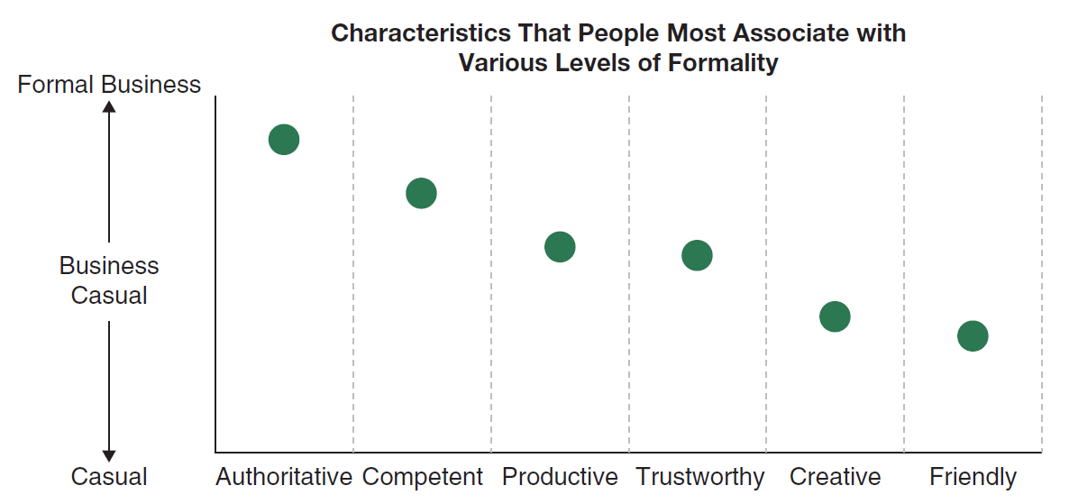
Figure 15.3 Messages Sent by Formality of Workplace Attire
Access the text alternative for slide images.
Source: Cardon, P. W., & Okoro, E. A. (2009). Professional characteristics communicated by formal versus casual workplace attire. Business Communication Quarterly, 72(3), 355–360.
Notes:
Your attire, and the level of formality you choose, projects a range of messages (see Figure 15.3). Generally, formal business attire projects authority and competence, high-level business casual is associated with productivity and trustworthiness, and low-level business casual is associated with creativity and friendliness. For business presentations, you should generally dress up slightly more formally than your audience.

Slide 16
Using Visual Aids and Handouts
Use Visuals without Losing Focus on You
Avoid turning out the lights in most cases.
Don’t start your slides right away.
Speak to your audience, not the screen.
Interpret, don’t read your slides.
Preview the slides before showing them.
Use a remote control to advance slides when possible.
Avoid standing in front of the slide projection.
Use blank slides strategically.
Notes:
Regardless of the technology you use, your goal is to keep yourself as the main focus of the presentation. Even with well-designed slides or videos, however, keeping the focus on you during the presentation can be challenging. Keep in mind the following tips as you present.

Slide 17

Use Handouts Effectively
Handouts
Make sense for detailed, numerical, and other information that is difficult to project adequately onto a screen.
Wait until the end of your presentation to distribute handouts.
Fizkes/Shutterstock
Notes:
If you can, wait until the end of your presentation to distribute handouts. This allows you to maintain more control over the message. If you need to use handouts during the presentation, consider how you might distribute them without losing control, especially during the opening one to two minutes of your presentation. Recall that audience members form many of their deepest impressions during this initial part of your presentation. Many presenters have lost the opportunity to connect effectively during their openings because of rustling handouts.

Slide 18
Interacting with Your Audience
Ways to Interact with Your Audience
Field questions.
Pause before answering.
Be honest.
Show appreciation.
Be concise.
Reframe the question to match your agenda.
Mingle and follow up.
Notes:
Good speakers involve the audience as much as possible without getting off message and taking too much time. A few ways to interact with your audience include fielding questions during the presentation as well as mingling and following up with audience members afterward.
Many of your presentations will involve a question-and-answer (Q&A) portion. Practice the following strategies to make the Q&A go as smoothly and effectively as possible.
When you complete your presentation, your work is not complete. In most cases, this is a good opportunity to work the room, further connecting with your audience. You can get additional feedback and discuss future endeavors with your listeners.

Slide 19
Table 15.4a Be Honest
Q. I know you’ve said that managers will like this new system, but you haven’t really talked about what managers wouldn’t like about the system. For me, I’d worry about this system eroding my authority to ask for real changes, especially if other employees are giving so much positive feedback. So, don’t you think this could actually upset some managers?
Less Effective | A. I guess that I haven’t really heard that concern yet. I think that managers might have a concern like that initially, but as they continue using the system they’ll notice they are actually empowered rather than having their authority eroded. | Latisha’s response glosses over the fact that she is not informed enough to give an accurate answer. Although she attempts to put a positive spin on the problem, she may appear dismissive of some listeners’ genuine concerns.
Notes:
Admit when you do not know the answer. Explain that you would like to get an answer to the question and seek an opportunity to continue the conversation later. In Table 15.4 see how Latisha responds when she doesn’t have a firm answer to a question.

Slide 20
Table 15.4b Be Honest
Q. I know you’ve said that managers will like this new system, but you haven’t really talked about what managers wouldn’t like about the system. For me, I’d worry about this system eroding my authority to ask for real changes, especially if other employees are giving so much positive feedback. So, don’t you think this could actually upset some managers?
More Effective | A. I’m not prepared to give a good answer to that question right now, but I think we certainly need to address it. Perhaps the HR team can ask some of our contacts at companies using continuous reviews to tell us their experiences with the challenges that managers face with these systems. If it’s okay with you, the HR team and I will get some answers to your question and email the entire senior management team within a week. | Latisha states that she is uncertain. However, she demonstrates a willingness to get the answer from reliable sources and promises to provide that information within a week. Overall, she gains credibility with her up-front, helpful response.

Slide 21
Table 15.5 Show Appreciation
Q. Do you think there’s a risk that because the feedback is public, managers and employees will avoid sharing their candid and real views of one another’s performance?
Less Effective | A. Actually, the system allows private feedback so that . . . | This is a good, rational response but could be improved with additional validation of the questioner.
More Effective | A. That’s a good question. We talked to four or five HR directors who have implemented continuous reviews, and they each initially had this concern. In practice, employees and managers use the private feedback feature when they offer negative or sensitive feedback. . . | By briefly validating the importance of the question, Latisha is able to demonstrate that she relates directly to this concern and that Eastmond Networking is committed to facilitating this communication. The response is strong rationally and emotionally.
Notes:
Fielding questions allows you to develop an emotional bond with the questioner. You can do so by sincerely showing thanks, recognizing the importance of the question, and otherwise validating the questioner, as Latisha does in the more effective example in Table 15.5.

Slide 22
Table 15.6 Be Concise
Q. You’ve mentioned a few success stories at Peakster Computing. Could you mention some examples at other companies you’ve talked to?
Less Effective | A. Sure. I could give you lots of examples. Let me tell you about three other companies. . . (continues on for three to four minutes largely repeating the same key points). | By providing such a lengthy answer, Latisha may inadvertently disengage some of her audience members who have already gotten her key points.
More Effective | A. Momentarily, I’ll distribute a handout with more comprehensive information from our research. The handout provides cases for four companies we worked with, so you’ll be able to see that the results at Peakster Computing are quite similar to those at the other three companies. | In this brief response (roughly 20 seconds), Latisha provides new information (that will be in a handout) and touches on but does not belabor key take-away points. This response has broad appeal since it allows audience members to locate additional results from other companies.
Notes:
As a rule of thumb, keep most responses to between 20 and 45 seconds. Pay close attention to your audience members during Q&A to see if they are remaining interested and engaged. See Table 15.6 to compare Latisha’s less- and more-concise responses.

Slide 23
Table 15.7a Reframe the Question to Match Your Agenda
Q. I’m quite skeptical that our company will get the dramatic results you’ve suggested. Do you really think a software program will help us reduce employee turnover?
Less Effective | A. Well, actually, I can’t guarantee anything. But, I can tell you with certainty that these types of software platforms have made dramatic differences in each company we’ve talked to. I think we’ll have similar results here. | This question challenges the basic premise that technology (a software platform) can make a difference. It may raise this doubt among other audience members as well. While the response is true, it fails to reframe the question in a way that focuses on how managers and employees help each other.
Notes:
When your listeners ask questions that could derail your agenda, find ways to tactfully reframe the conversation in favor of your objectives, as Latisha’s does in the examples in Table 15.7.

Slide 24
Table 15.7b Reframe the Question to Match Your Agenda
Q. I’m quite skeptical that our company will get the dramatic results you’ve suggested. Do you really think a software program will help us reduce employee turnover?
More Effective | A. I think it’s fair to say that we can reduce employee turnover by focusing on performance in a more positive and motivating way. What we’ve learned from these other companies is that they used the software successfully because they created a culture of performance where managers and employees are giving one another more frequent, more positive, and more candid feedback. This energizing environment is what reduced employee turnover. So, I’d say creating this culture with the help of these software tools will help us reduce employee turnover. | This response reframes the conversation by emphasizing how managers and employees encouraging one another to improve is the key driver of lower employee turnover. This response is successfully reframed to address the questioner’s real concern: Technology isn’t the solution.

Slide 25
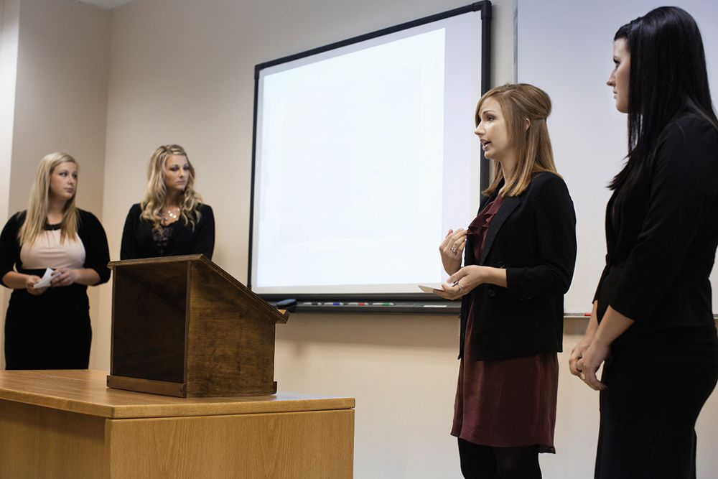
Present Effectively in Teams
How to Present
Be clear with one another about your objectives and key messages.
Decide on your presentation roles.
Stand together and present a united front.
Refer to one another’s points.
Transition effectively.
Notes:
You’ll often have the opportunity to present in teams. Delivering an effective team presentation involves the same principles as an individual presentation with a few complications to address. The key is to plan for these issues well ahead of the presentation.

Slide 26
Being a Supportive Audience Member
Take the role of audience member seriously.
Avoid behaviors that may distract the presenter.
Make comments and ask questions that help the presenter stay on message.
Notes:
You will likely be an audience member more often than you are a presenter. Take this role seriously. Do all you can to support the presenter. Show interest by maintaining eye contact and sitting up straight. Avoid behaviors that may distract the presenter, such as glancing at your mobile phone or yawning. Make comments and ask questions that help the presenter stay on message. In most cases, you share professional interests with the presenter. As a result, the success of the presentation is a team effort.

